Slide 1
Security Attacks

Slide 2
Classify Security Attacks
passive attacks - monitoring of, transmissions to:
  obtain message contents, or
  monitor traffic flows
active attacks – modification of data stream to:
  masquerade of one entity as some other
  replay previous messages
  modify messages in transit
  denial of service
Bill Figg

Slide 3
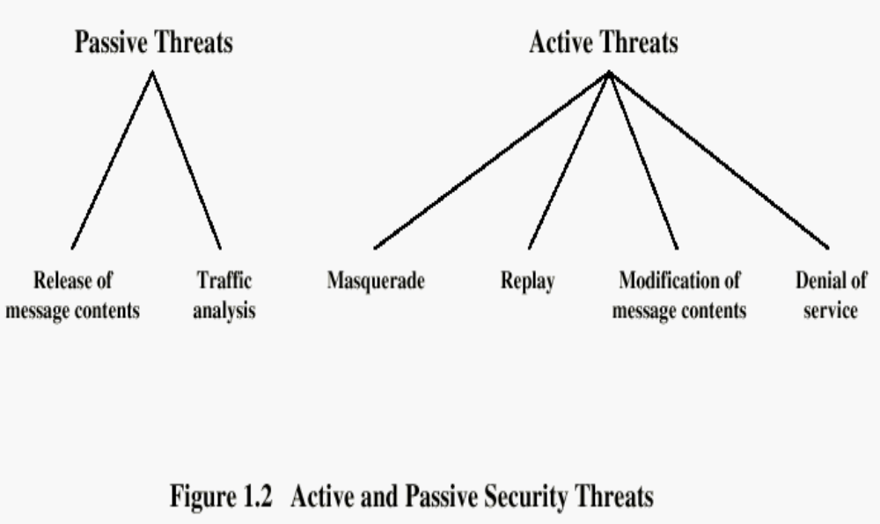
Types of Attacks
Bill Figg

Slide 4
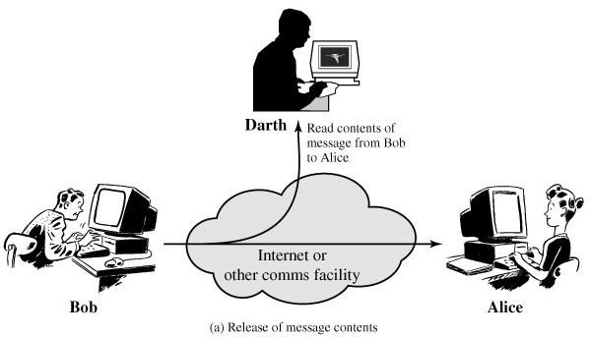
Passive Threats
1. Release of message contents

Slide 5
Passive Threats cont.
1. Release of message contents :
The release of message contents is easily understood (Figure 1).
A telephone conversation, an electronic mail message, and a transferred file may contain sensitive or confidential information. We would like to prevent an opponent from learning the contents of these transmissions.

Slide 6
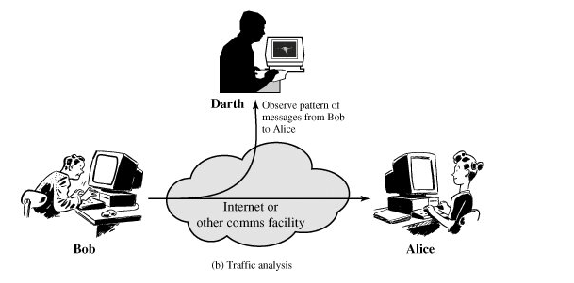
Passive Threats cont.
2.Traffic Analysis:

Slide 7
Passive Threats cont.
2.Traffic Analysis :
A second type of passive attack, traffic analysis, is subtler (Figure 2). Suppose that we had a way of masking the contents of messages or other information traffic so that opponents, even if they captured the message, could not extract the information from the message.
The common technique for masking contents is encryption. If we had encryption protection in place, an opponent might still be able to observe the pattern of these messages.

Slide 8
Active Attacks
Active attacks involve some modification of the data stream or the creation of a false stream and can be subdivided into four categories:
1.masquerade,
2.replay,
3. modification of messages, and
4. denial of service.

Slide 9
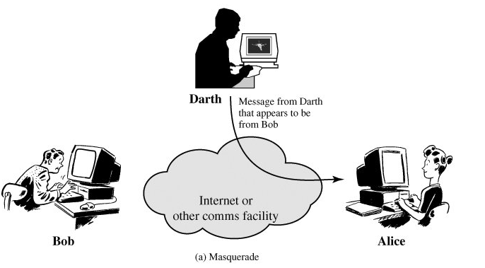
Masquerade

Slide 10
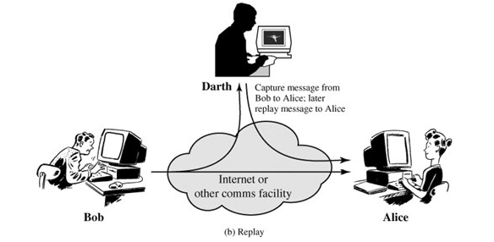
Replay

Slide 11
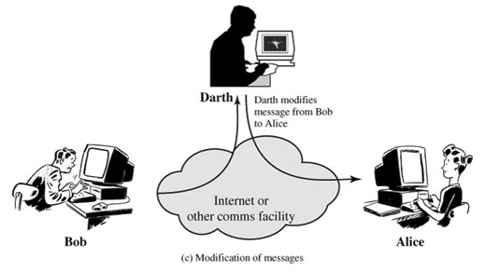
Modification of Message

Slide 12
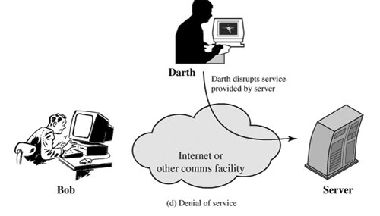
Denial of Service

Slide 13
Active Attack
A masquerade takes place when one entity pretends to be a different entity (fig.c).
Replay involves the passive capture of a data unit and its subsequent retransmission to produce an unauthorized effect (Fig.D).
Modification of messages simply means that some portion of a legitimate message is altered, or that messages are delayed or reordered, to produce an unauthorized effect (Figure E). For example, a message meaning "Allow John Smith to read confidential file accounts" is modified to mean "Allow Fred Brown to read confidential file accounts.“
service denial is the disruption of an entire network, either by disabling the network or by overloading it with messages so as to degrade performance. (Fig F)

